Slide 1
Don't Keep it Bottled Up: An Analysis of Black Glass Wine Bottles at Historic Huguenot Street New Paltz, NY
by Reuben Slater
Under the guide of Joseph Diamond and Michael Vargas

Slide 2
Research Question
What can an analysis of the remains of black glass wine vessels recovered from archaeological excavations at Historic Huguenot Street illuminate about the lifeways of New Paltz’ Huguenot settlers, and colonial life in the Hudson Valley at large?

Slide 3
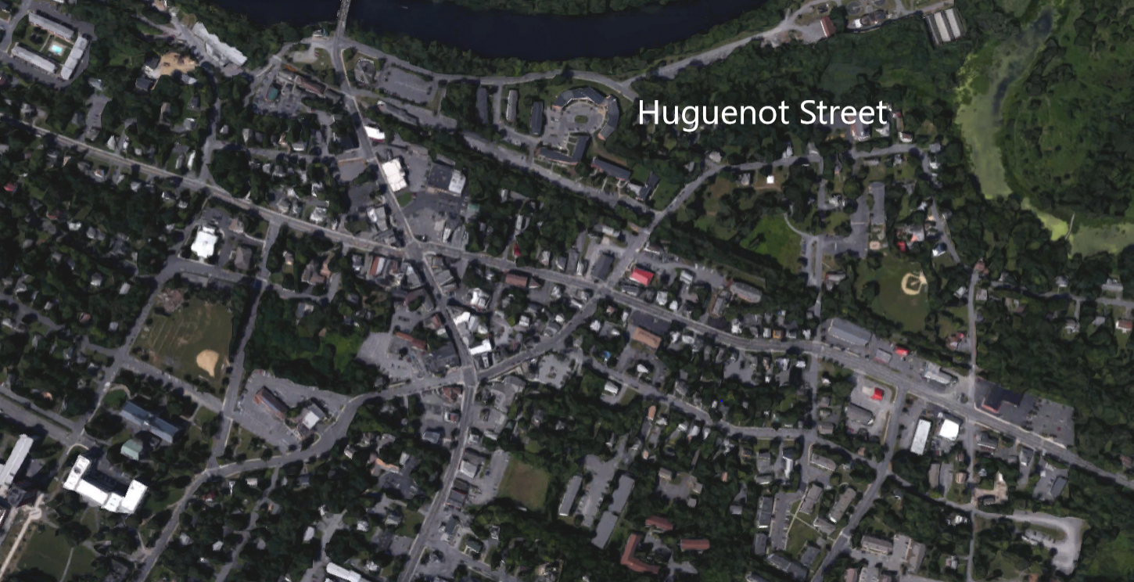
Huguenot street
You are here

Slide 4
Background
  The Huguenots, are a French Protestant group of Calvinists, who trace their origins to 16th century France.

Slide 5
Background
The Huguenots, are a French Protestant group of Calvinists, who trace their origins to 16th century France.
Living in a majority Catholic country they were subject to religious persecution.

Slide 6
Background
The Huguenots, are a French Protestant group of Calvinists, who trace their origins to 16th century France.
Living in a majority Catholic country they were subject to religious persecution.
Over the next couple centuries the Huguenots would disperse to “safer” European countries and ultimately Colonial America.

Slide 7
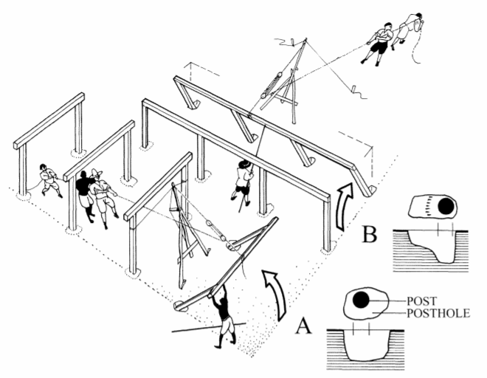
Background
The Huguenots, are a French Protestant group of Calvinists, who trace their origins to 16th century France.
Living in a majority Catholic country they were subject to religious persecution.
Over the next couple centuries the Huguenots would disperse to “safer” European countries and ultimately Colonial America.
In 1677 the various Huguenot families which New Paltz is named after bought 40,000 acres of land from the Munsee Native Americans and started to build the first homes on what is now Historic Huguenot Street in 1678.
Carson, Cary, Joanne Bowen, Willie Graham, Martha McCartney, and Lorena Walsh. "New World, Real World: Improvising English Culture in Seventeenth-Century Virginia." The Journal of Southern History 74, no. 1 (2008): 31-88.

Slide 8
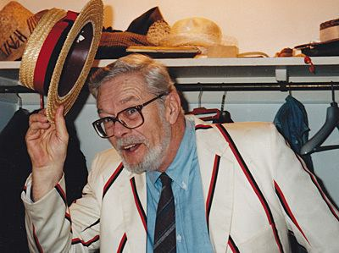
Theory
Louis Binford: “Archaeology as Anthropology” 1962.
Notes:
Excavations have been taking place every summer since 1998!
All units are done for the most part in 2x2 meter squares, with 10 cm contexts

Slide 9
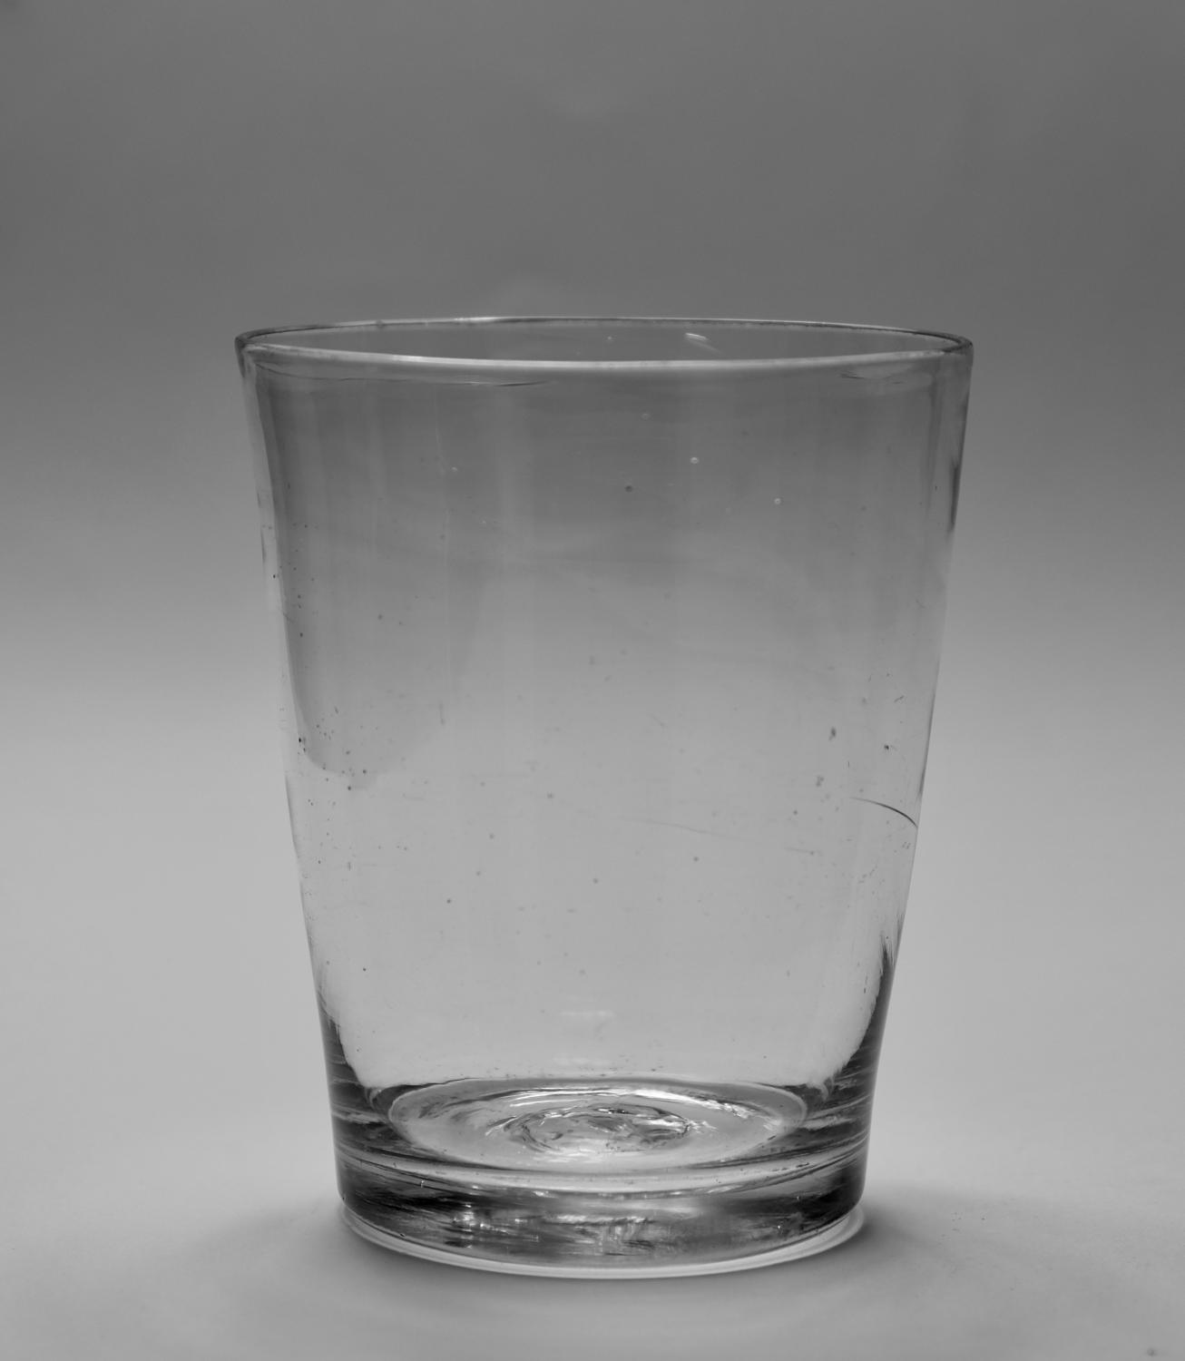
Theory
Louis Binford: “Archaeology as Anthropology” 1962.
Technomic artifacts: artifacts which have “their primary functional context in coping directly with the physical environment.” (Binford, 1962:219)
Plain eighteenth century tumbler

Slide 10
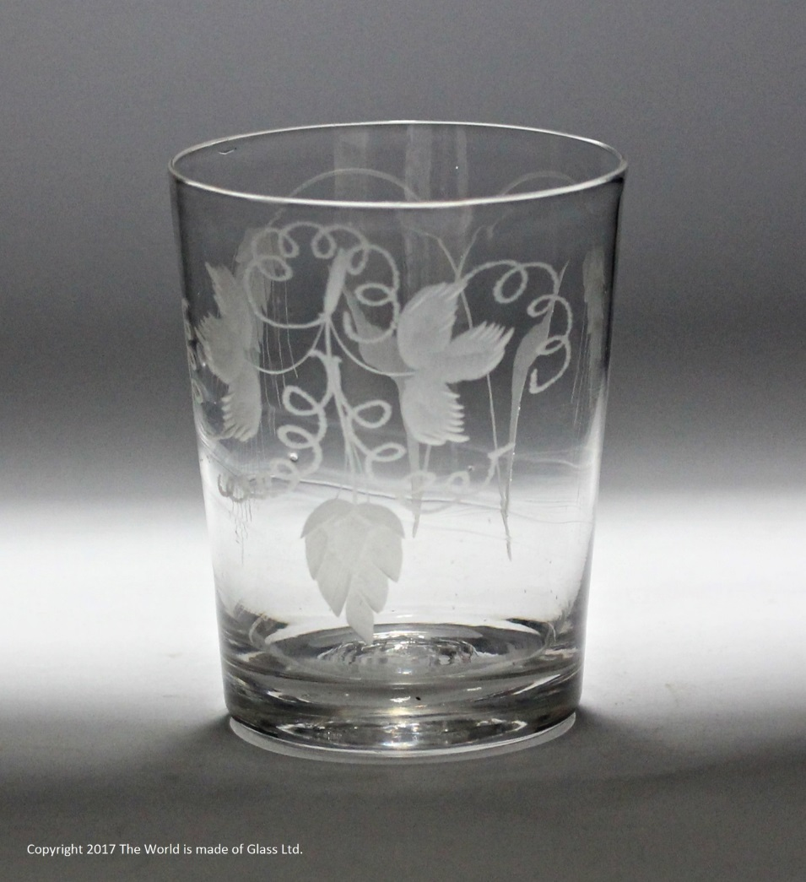
Theory
Louis Binford: “Archaeology as Anthropology” 1962.
Technomic artifacts: artifacts which have “their primary functional context in coping directly with the physical environment.” (Binford, 1962:219)
Sociotechnic artifacts: provide “extra-somatic” information on the individual it belonged to, allowing the archaeologist to derive social status. (Binford, 1962:219)
Hop and Barley engraved tumbler

Slide 11
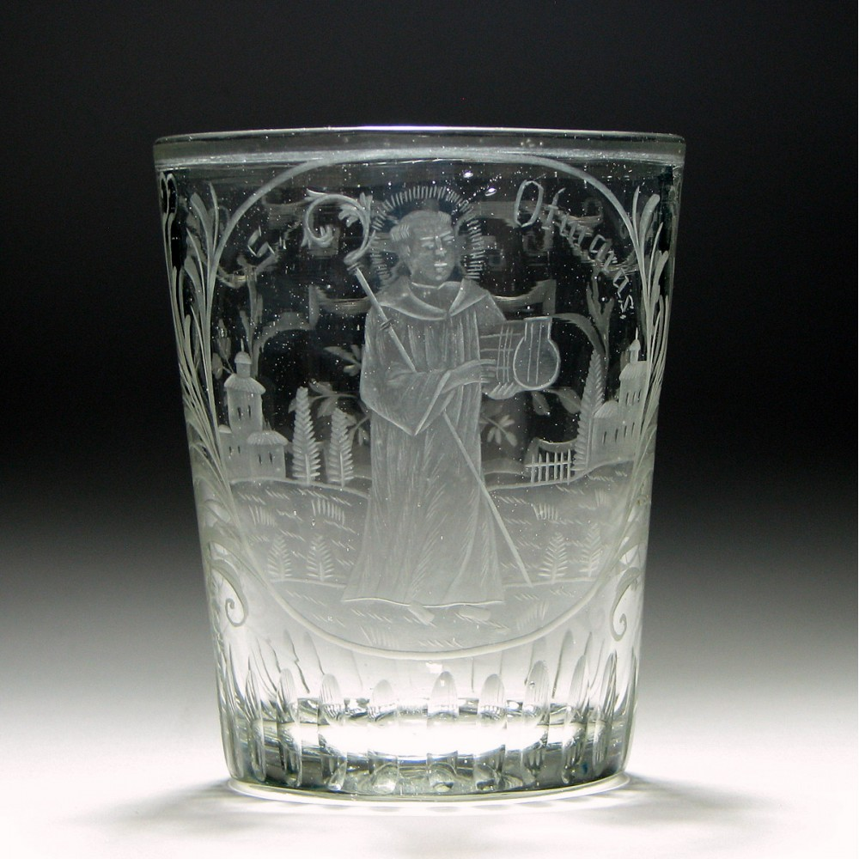
Theory
Louis Binford: “Archaeology as Anthropology” 1962.
Technomic artifacts: artifacts which have “their primary functional context in coping directly with the physical environment.” (Binford, 1962:219)
Sociotechnic artifacts: provide “extra-somatic” information on the individual it belonged to, allowing the archaeologist to derive social status. (Binford, 1962:219)
Ideotechnic artifacts: clue the archaeologist as to what the dominant ideologies of a culture are and the ways in which said ideologies get adopted by constituents of the culture.
Saint Otmarus Tumbler
Notes:
St. Otmarus is also Saint Audomar of which Saint-Omer France is named.

Slide 12
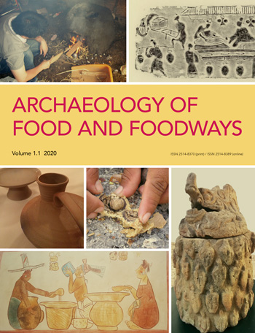
Theory
Foodways: Allows the archaeologist to analyze food/drink related artifacts out of the realm of pure subsistence into the cultural-social and economic realms, providing insight into how people cognitively compartmentalize ideas about food and how it relates to their role in society.

Slide 13
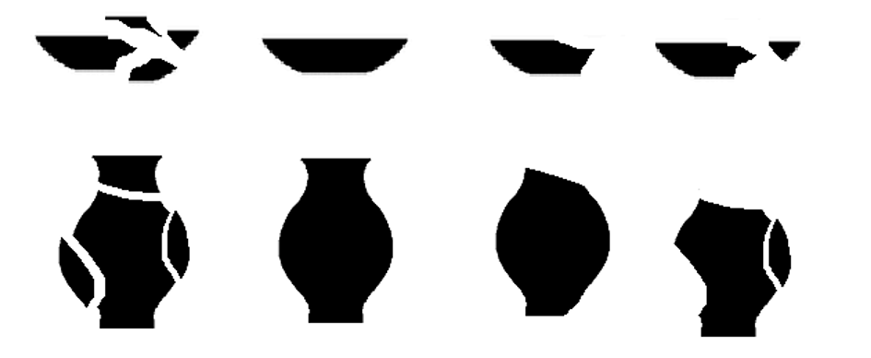
Methodology: Minimum Number of Vessels analysis (MNV).
Voss, Barbara l, Allen, Rebecca. 2010. “Guide to Ceramic MNV Calculation Qualitative and Quantitative Analysis.” Technical Briefs in Historical Archaeology. 5 (1): 1-9.

Slide 14
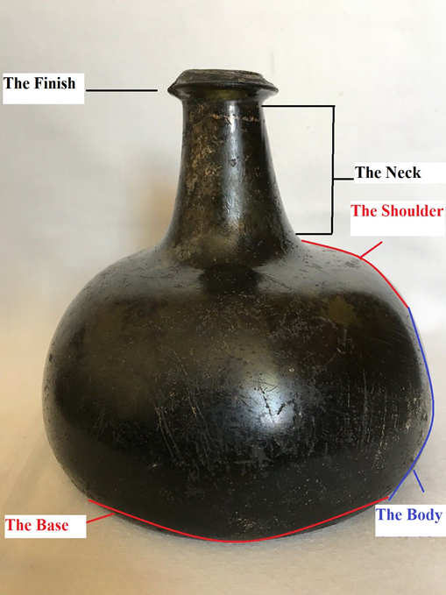
Methodology: Minimum Number of Vessels analysis (MNV).
“Instead of counting sherds, learn to look instead at the numbers of rim sherds, bases, or other attributes to help determine how many whole artifacts were once on the site, not the number of broken pieces.” (Voss et. Al, 2010:2)

Slide 15
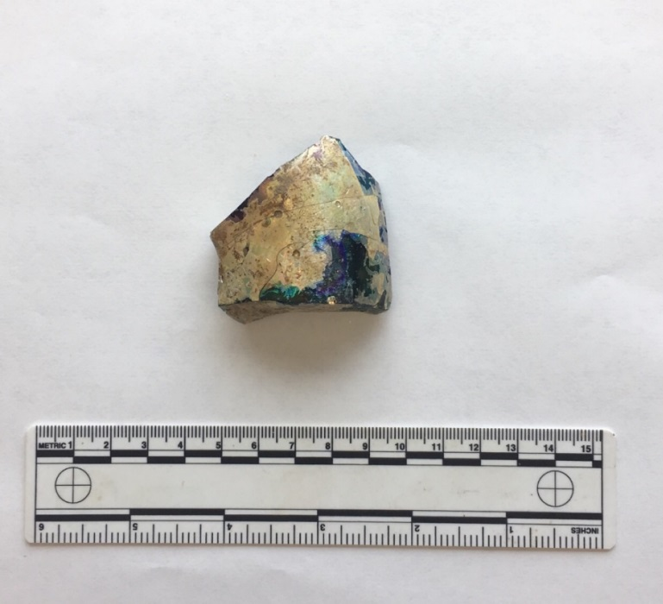
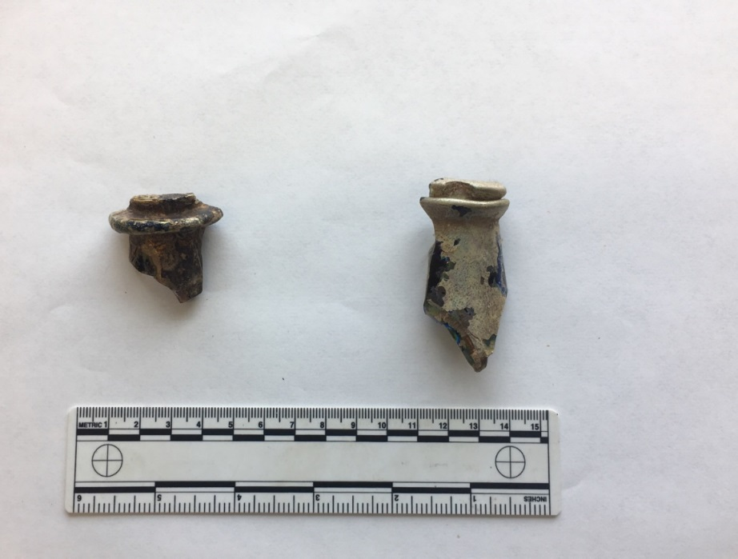
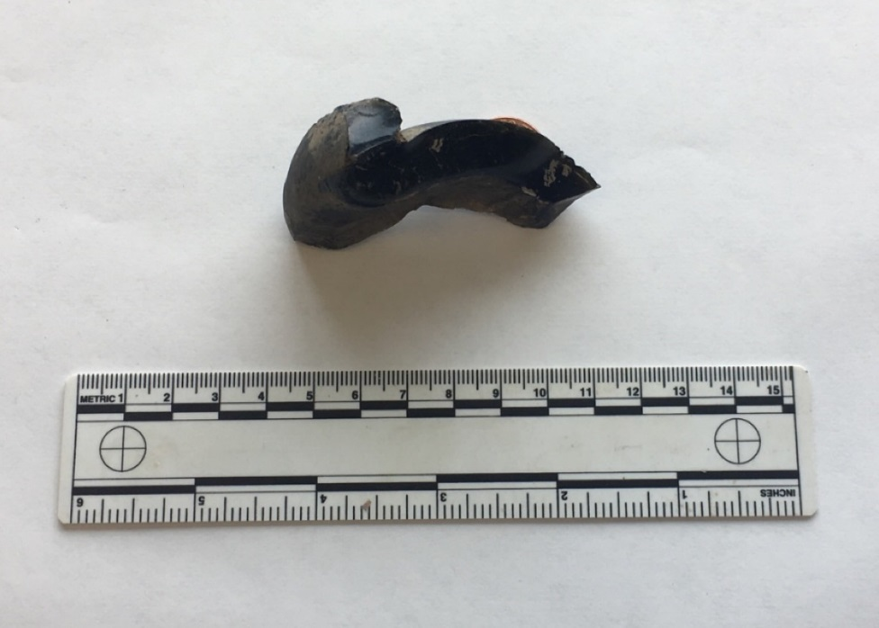
Methodology: Minimum Number of Vessels analysis (MNV).
Base Fragment
Lip Fragments
Bottle Base/Kick Up Fragment

Slide 16
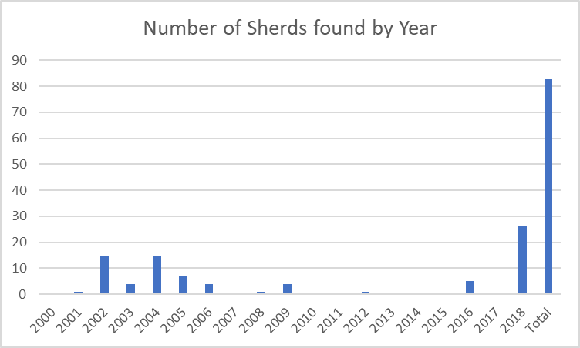
Data Analysis
In total 83 sherds have been excavated from 2000-2018.

Slide 17
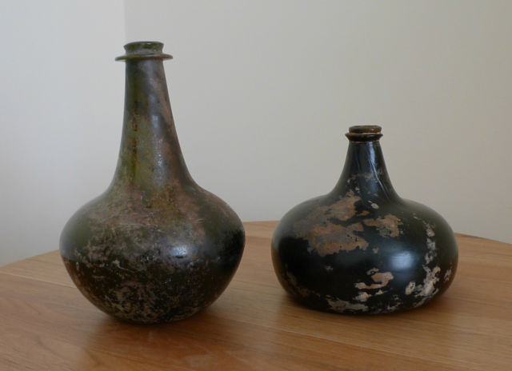
Data Analysis
In total 83 sherds have been excavated from 2000-2018.
After conducting a MNV analysis, we found five whole vessels to be represented, three of them being “Onion bottles” the other two being “Shaft and Globe” style.

Slide 18
Data analysis
In total 83 sherds have been excavated from 2000-2018.
After conducting a MNV analysis, we found five whole vessels to be represented, three of them being “Onion bottles” the other two being “Shaft and Globe” style.
All of the sherds analyzed can be categorized into the technomic realm.

Slide 19
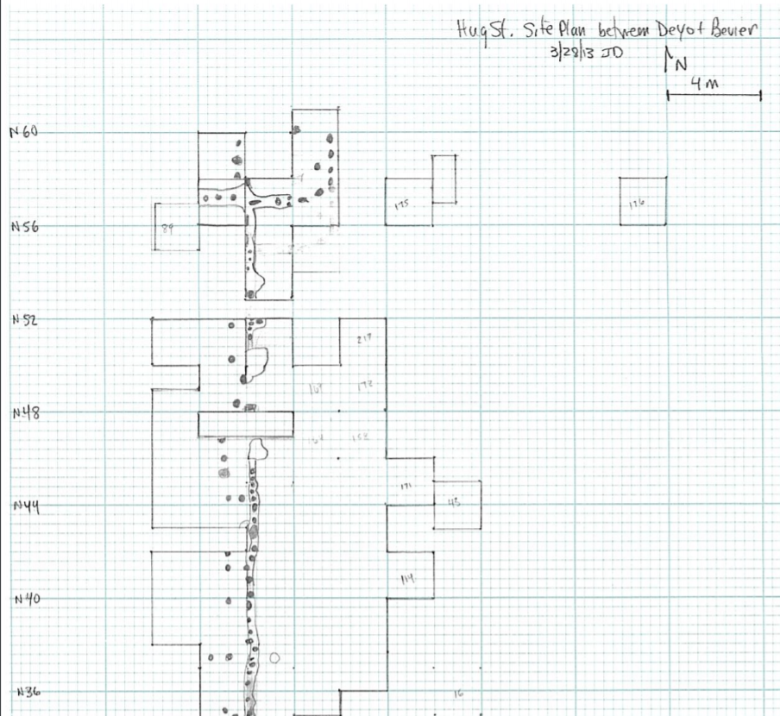
Discussion
Due to the vessels provenience near the site of an Earthfast house it can be argued that the bottles were of household use.
Furthermore, the sparse number of sherds reinforces the idea of singular household drinking.

Slide 20
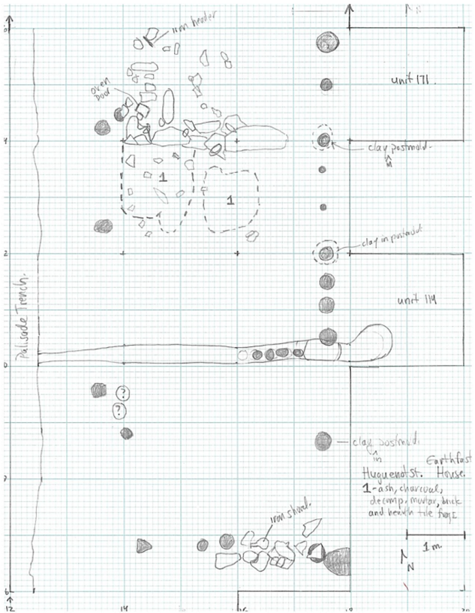
Discussion
Due to the vessels provenience near the excavated earthfast house it can be argued that the bottles were of household use.
Furthermore, the sparse number of sherds reinforces the idea of singular household drinking.
With no presence of seventeen century drinking glasses on Huguenot Street, these bottles were most likely used as decanters to hold and drink wine, beer, ale and whiskey.

Slide 21
Discussion
However, while the glass bottles themselves exist in the technomic realm, they have been found with stoneware jugs, which alcohol was poured into, that can be classified into the sociotechnic and ideotechnic realms.
Overall, the black glass assemblage at Huguenot Street reflects the broader socio-cultural and political lives of the early Huguenots, who fleeing religious persecution lived a life focused on survival on the frontier.

Slide 22
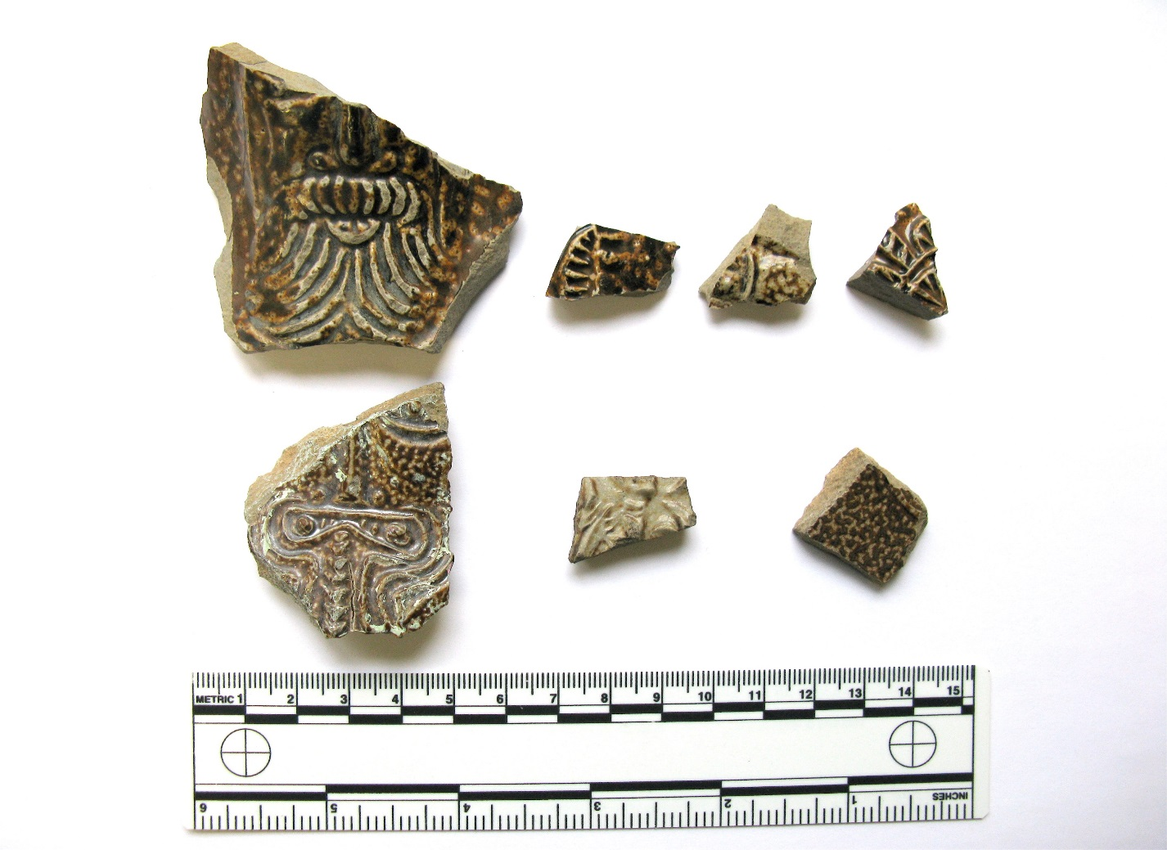
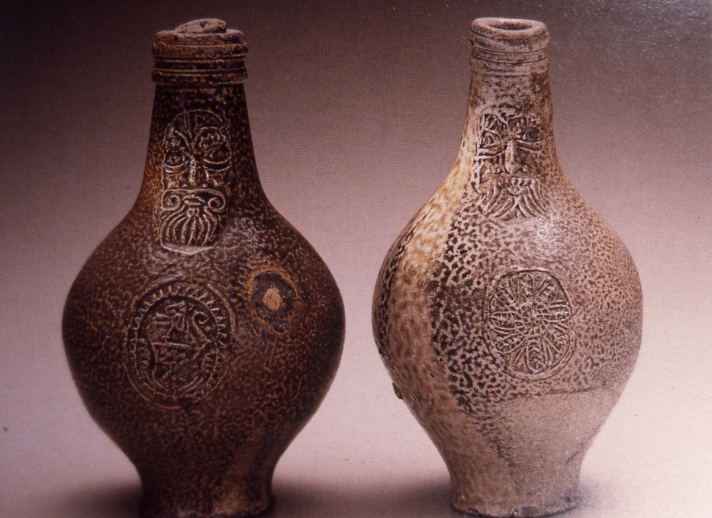

Slide 23
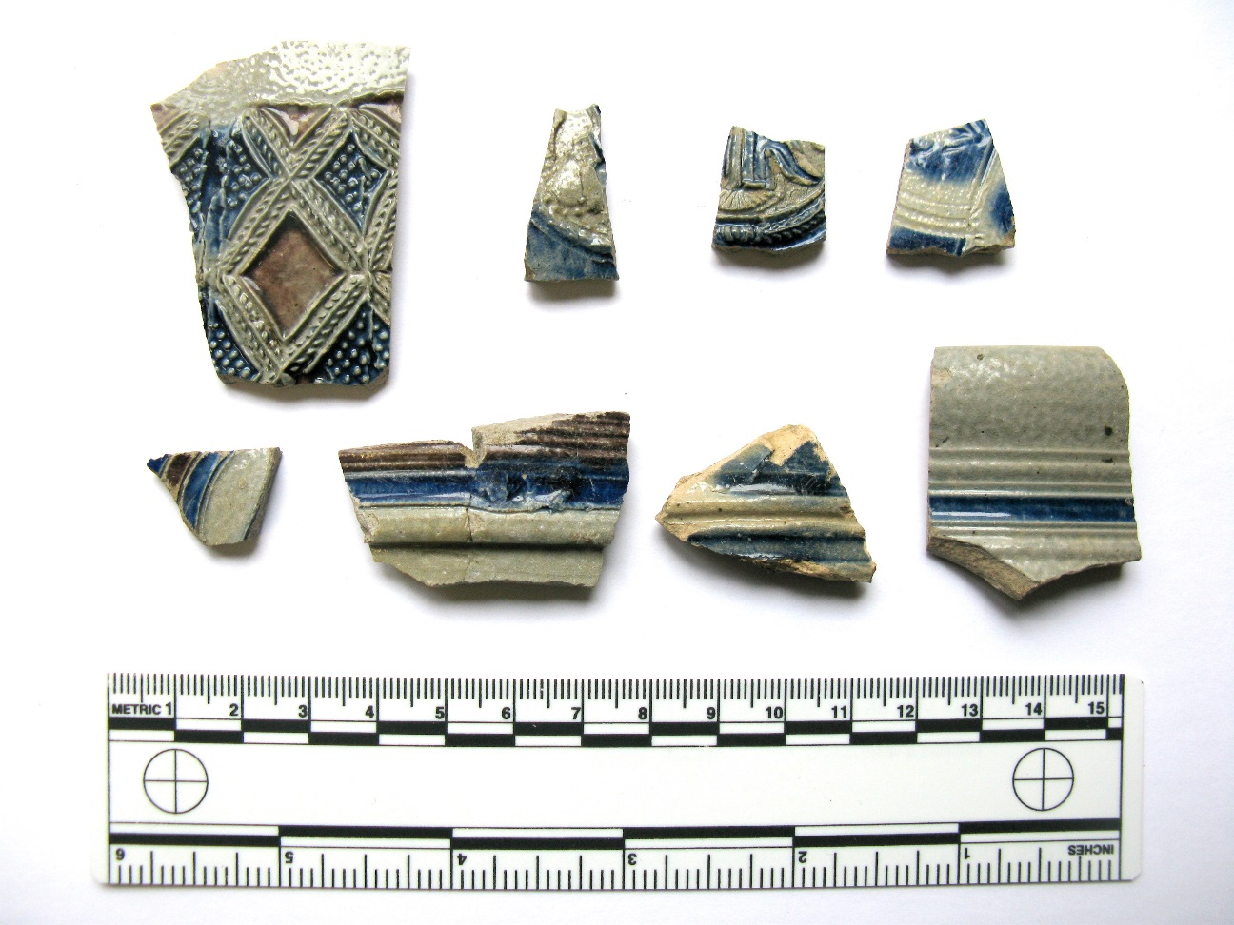
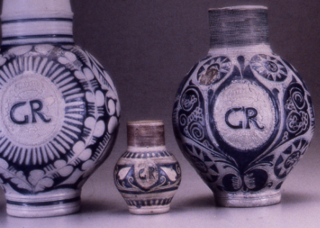

Slide 24
Bibliography
Binford, Lewis R. 1962. "Archaeology as Anthropology". American Antiquity. 28 (2): 217-225.
Carson, Cary, Joanne Bowen, Willie Graham, Martha McCartney, and Lorena Walsh. "New World, Real World: Improvising English Culture in Seventeenth-Century Virginia." The Journal of Southern History 74, no. 1 (2008): 31-88.
https://alchetron.com/Lewis-Binford
https://www.huguenotstreet.org/our-history)
https://sites.newpaltz.edu/news/2018/08/ground-penetrating-radar-enables-new-archaeological-discovery-at-historic-huguenot-street/.
https://historicjamestowne.org/selected-artifacts/nicholson-bottles/
Voss, Barbara l, Allen, Rebecca. 2010. “Guide to Ceramic MNV Calculation Qualitative and Quantitative Analysis.” Technical Briefs in Historical Archaeology. 5 (1): 1-9.

